Slide 1

O
h, give thanks to the Lord
for He is good!
Psalm 118:1

Slide 2
o
O

Slide 3
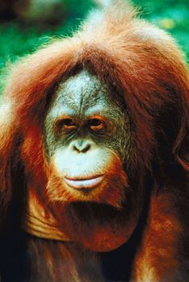

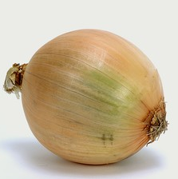
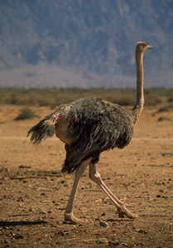

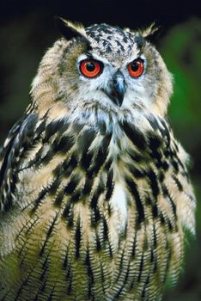

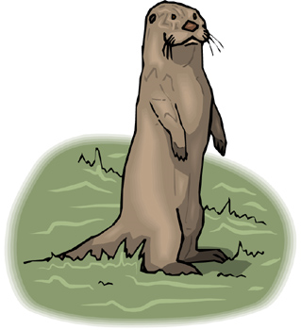
O is for…
orangutan
octopus
onion
ostrich
orange
oars
oval
otter
owl

Slide 4
25

Slide 5
25 circles
1
2
3
4
5
6
7
8
9
10
11
12
13
14
15
16
17
18
19
20
21
22
23
24
25

Slide 6
orange

Slide 7

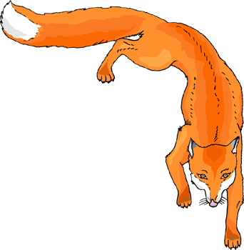

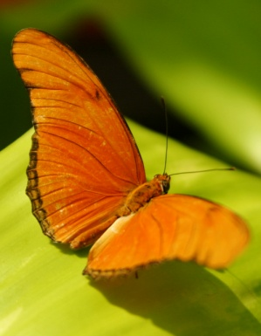





orange

Slide 8
g
o
o
d

Slide 9

Good
For Me

Slide 10
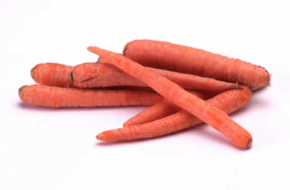
Carrots are good for me.

Slide 11

Peas are good for me.

Slide 12
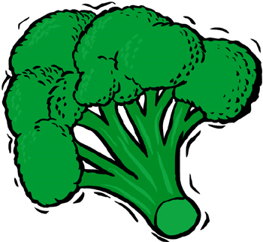
Broccoli is good for me.

Slide 13
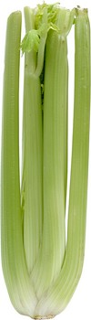
Celery is good for me.

Slide 14
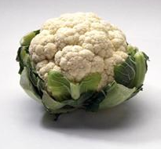
Cauliflower is good for me.

Slide 15
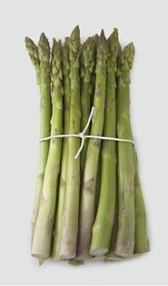
Asparagus is good for me.

Slide 16
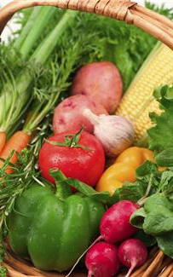
Vegetables are good for me.

Slide 17
Oo
25
good

Slide 18
Ss
24
he

Slide 19
Gg
23
go

Slide 20
Cc
22
in

Slide 21
Uu
21
we

Slide 22
Jj
20
said

Slide 23
Rr
19
it

Slide 24
Bb
18
they

Slide 25
Pp
17
to

Slide 26
Dd
16
all

Slide 27
Ww
15
we

Slide 28
Mm
14
my

Slide 29
Kk
13
your

Slide 30
Aa
12
away

Slide 31
Zz
11
down

Slide 32
Nn
10
one

Slide 33
Yy
9
you

Slide 34
Vv
8
me

Slide 35
Xx
7
little

Slide 36
Ee
6
is

Slide 37
Ff
5
for

Slide 38
Ii
4
can

Slide 39
Hh
3
and

Slide 40
Tt
2
the

Slide 41
L l
1
see

Slide 42
O
h, give thanks to the Lord
for He is good!
Psalm 118:1

Slide 43
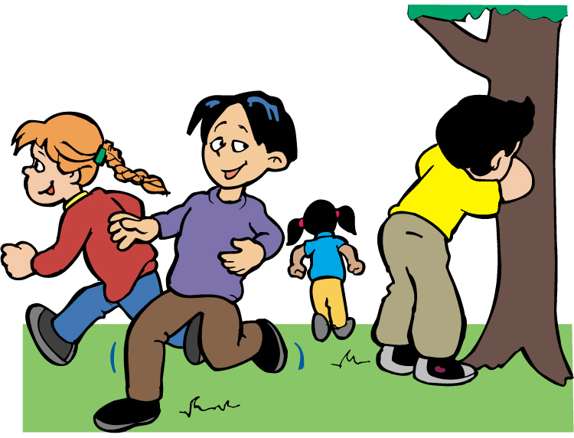
S
eek the Lord
while He may be found.
Isaiah 55:6

Slide 44

G
o into all the world
and preach the gospel
to every creature.
Matthew 16:15

Slide 45
C
hildren, obey your parents
in all things
for this is well pleasing
to the Lord.
Colossians 3:20

Slide 46
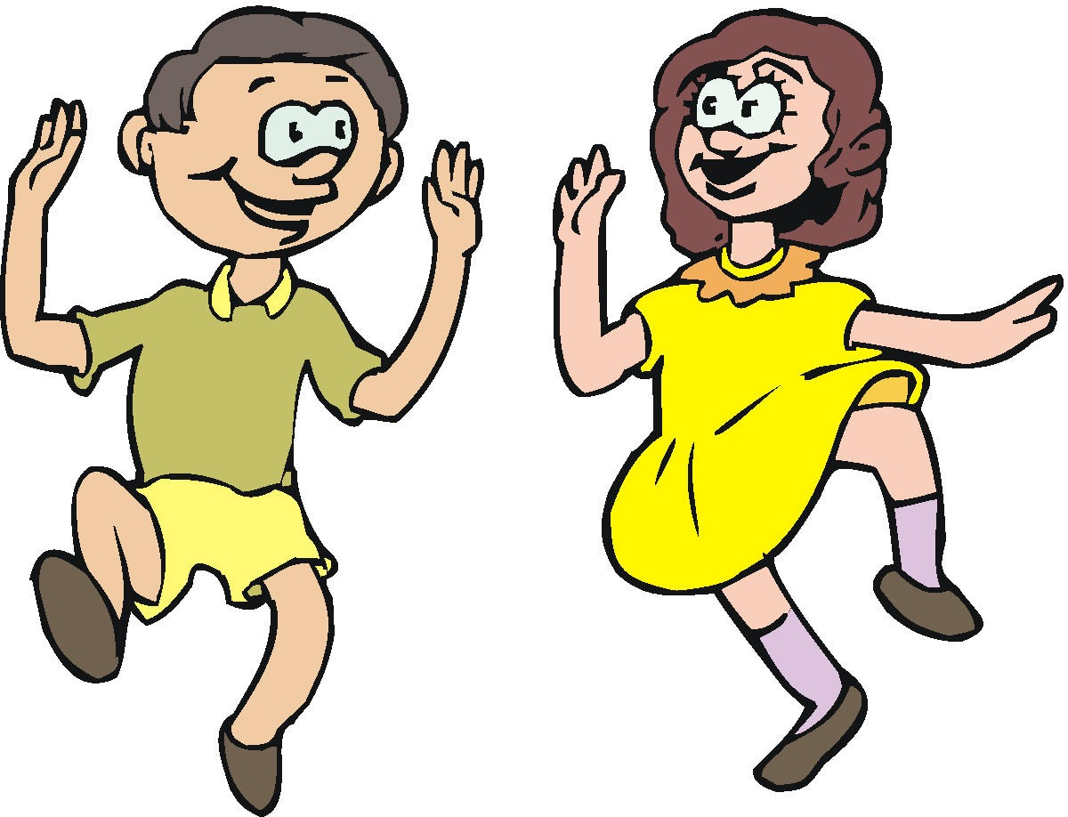
U
nto Thee, oh God,
do we give thanks.
Psalm 75:1

Slide 47

J
esus said to him,
I am the way, the truth,
and the life.
John 14:6

Slide 48

R
emember the Sabbath day,
to keep it holy.
Exodus 20:8

Slide 49

B
lessed are the peacemakers,
for they shall be called
sons of God.
Matthew 5:9

Slide 50

raise the Lord!
For it is good to sing praises to our God.
P
Psalm 147:1

Slide 51

o all things without
complaining or disputing.
D
Philippians 2:14

Slide 52

e love him
because he first
loved us.
W
1 John 4:19

Slide 53

y little children,
let us not love in word or in tongue,
but in deed and in truth.
M
1 John 3:18

Slide 54

eep your tongue from evil.
K
Psalm 34:13

Slide 55
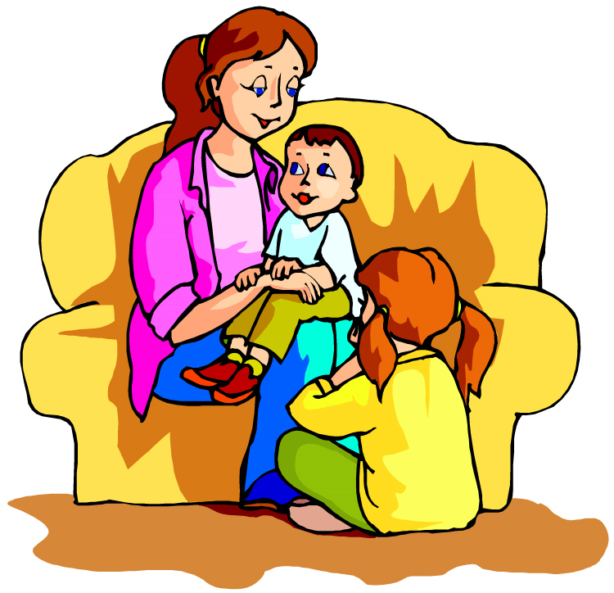
soft answer turns away wrath.
A
Proverbs 15:1

Slide 56
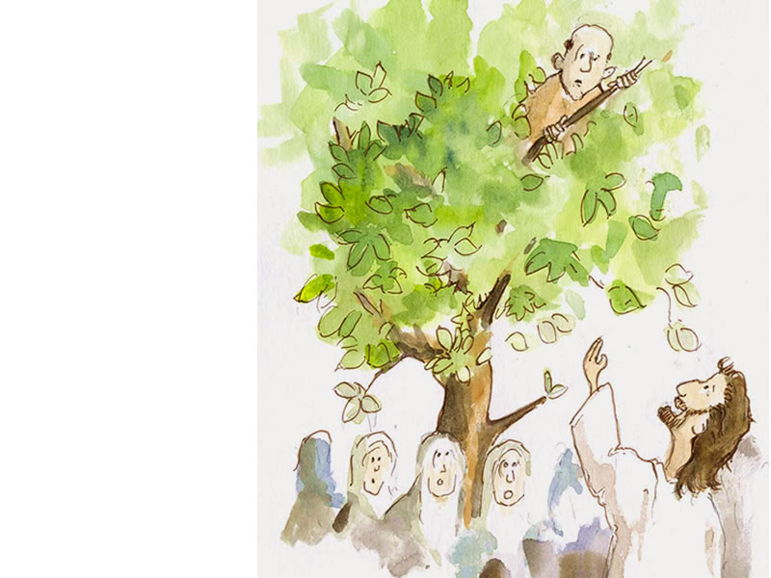
acchaeus, make haste and come down,
for today I must stay at your house.
Z
Luke 19:15

Slide 57
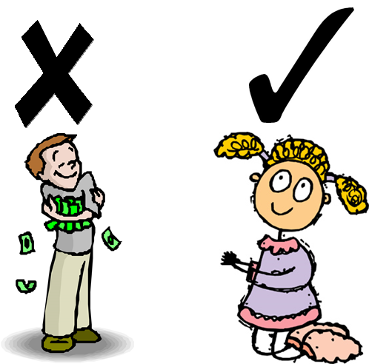
N
o one can serve
two masters.
Matthew 6:24

Slide 58

Y
ou are my friends
if you do whatever
I command you.
John 15:14

Slide 59

V
erily, verily I say unto you,
he that believeth on me
hath everlasting life.
John 6:47

Slide 60

X
E cept you be converted
and become as little children,
you shall not enter
the kingdom of heaven.
Matthew 18:3

Slide 61

E
ven a child is known
by his deeds.
Proverbs 20:11

Slide 62
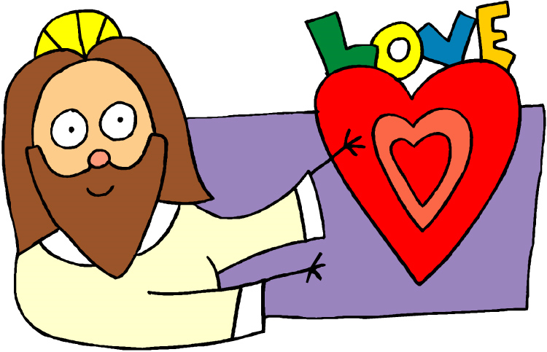
F
or God so loved the world
that He gave His only begotten Son,
that whoever believes in Him
should not perish but have everlasting life.
John 3:16

Slide 63

I
can do all things through
Christ who strengthens me.
Philippians 4:13

Slide 64
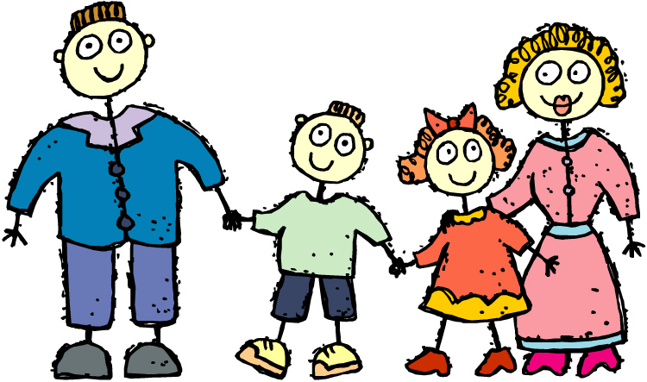
H
onor your father
and your mother.
Exodus 20:12

Slide 65
T
hou shall not steal.
Exodus 20:15

Slide 66

L
et your light shine before men,
that they may see
your good works
and glorify your Father in heaven.
Matthew 5:16

